Slide 1
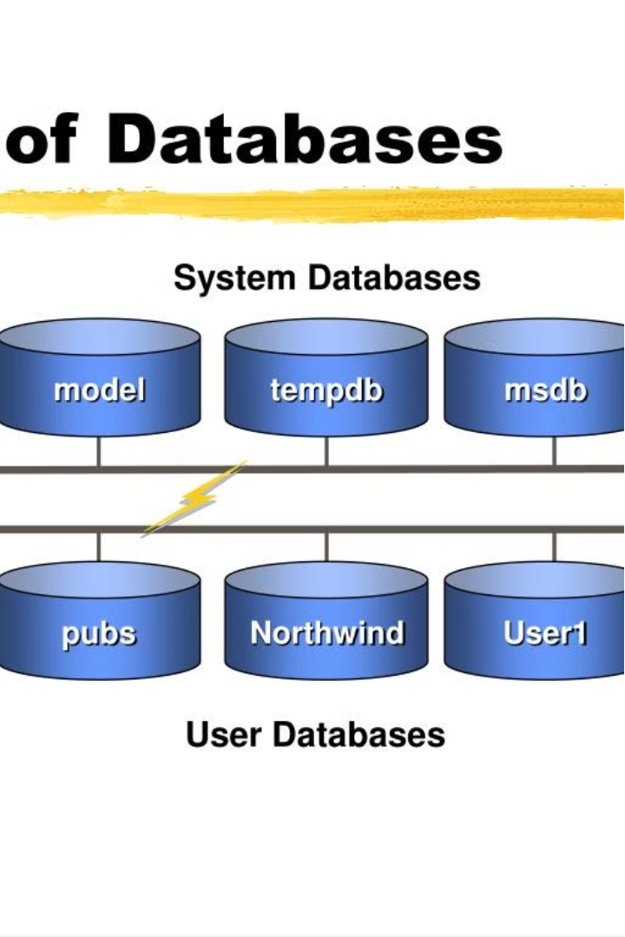
Introduction to SQL GROUP BY
statement.
The SQL GROUP BY statement is a powerful tool that allows you to group rows that have the same values into summary rows. This is useful for performing aggregate functions like SUM, AVG, COUNT on grouped data to gain valuable insights from your data.
by :k SHREESHANTH GOUDA

Slide 2
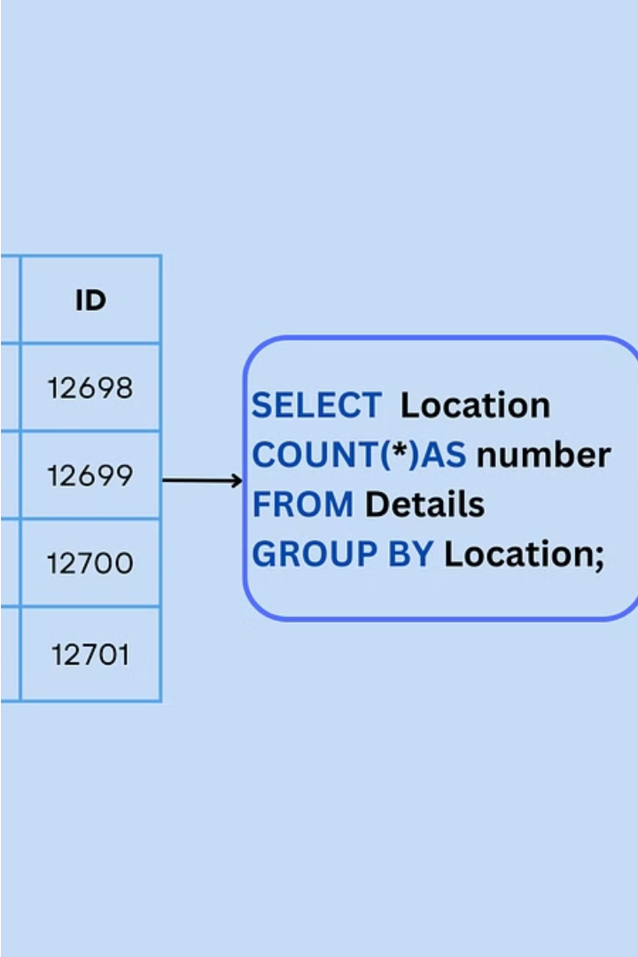
Purpose and Syntax of GROUP BY
The purpose of GROUP BY is to combine rows that have the same values into a single row, allowing you to apply aggregate functions to each group. The basic syntax is: SELECT column1, aggregate_function(column2) FROM table GROUP BY column1;

Slide 3

Aggregate Functions with GROUP BY
When used with GROUP BY, aggregate functions like SUM, AVG, COUNT, MIN, and MAX can be applied to each group to perform calculations. For example, you could use SUM(sales) GROUP BY product_id to get the total sales for each product.

Slide 4
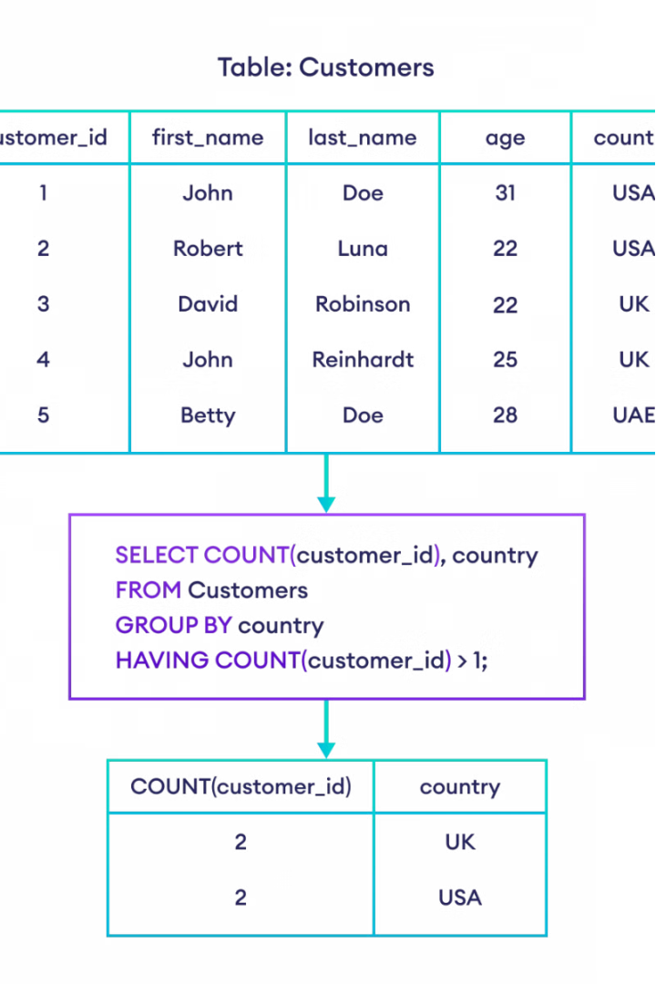
Difference Between WHERE and HAVING Clauses
The key difference is that WHERE is used to filter rows before grouping, while HAVING filters the groups after they've been created by GROUP BY. WHERE applies to individual rows, while HAVING applies to the summarized groups.

Slide 5
Using WHERE with GROUP BY
Example
Explanation
SELECT department, SUM(salary) AS total_salary FROM employees WHERE department != 'HR' GROUP BY department;
The WHERE clause filters the individual rows first, before the GROUP BY is applied. This allows you to only group the rows that match the WHERE condition.

Slide 6
Using HAVING with GROUP BY
Example
Explanation
SELECT department, SUM(salary) AS total_salary FROM employees GROUP BY department HAVING SUM(salary) > 1000000;
The HAVING clause filters the grouped data, allowing you to only include groups where the aggregate function meets the specified condition.

Slide 7

Advantages of GROUP BY
1
Summarize Data
2
Perform Calculations
3
Gain Insights
The summarized data from GROUP BY can provide valuable insights that are difficult to obtain from the raw data.
GROUP BY allows you to easily summarize large datasets by grouping rows with the same values.
When combined with aggregate functions, GROUP BY enables you to perform calculations on grouped data.

Slide 8
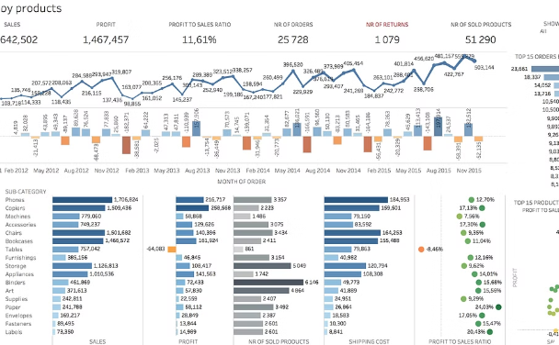
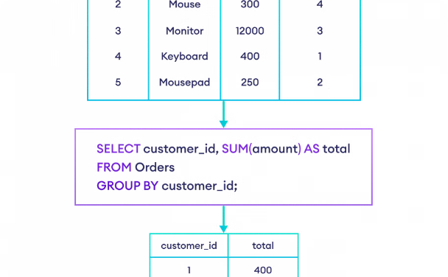
Practical Examples of GROUP BY
Sales Analysis
Customer Segmentation
GROUP BY product_id and SUM(sales) to get total sales per product, enabling better inventory management.
GROUP BY region and COUNT(customer_id) to identify high-value regional markets for targeted marketing.

